Slide 1
Final Presentation Identification of an Anonymous Reviewer of an Academic Paper
Students: Roy Hachnochi, Lior Kiassi
Supervisor: Pavel Lifshits
Semester: Spring, 2020
Date: 24/11/20

Slide 2
Outline
Introduction & background
Toy problem
Datasets
Main project
Results & conclusions
Future work

Slide 3
Project Goal
Study the domain of a new problem – reviews on academic papers.
Gain an understanding on how to perform authorship attribution on this domain by learning a different domain.
Stepping-stone towards the following:
Dealing with the cross-domain problem – learning on academic papers and inferring on reviews.
Obfuscation of reviews’ authors.

Slide 4
Motivation/Problem Statement
Commonly, as part of the process of publishing a scientific paper, the work undergoes peer review.
“Double Blind” – the author and the reviewer are anonymous to each other.
Today, due to transparency reasons, several well-known journals publish their reviews.

Slide 5
NLP- Background
“Natural Language” - any language that has evolved naturally in humans through use and repetition without conscious planning or premeditation.
Can take different forms, such as speech or signing.
Distinguished from constructed and formal languages (programming languages, logic study and more).

Slide 6
NLP- Background
Natural Language Processing deals with the interaction between computers and humans using the natural language.
Mostly involves using of ML and DL techniques.
Highly studied field due to relevance for Artificial Intelligence.

Slide 7
Authorship Attribution - Background
An NLP task of identifying the author of a text.
Worldwide interest – wide range of applications including forensic investigation and plagiarism detection.
Various tasks:
Attribution
Profiling (age, gender and more)
Genre identification
Verification/obfuscation/clustering and more

Slide 8
Challenges In The Problem
No existing labeled ground truth.
Reviews are short texts.
Reviews and academic papers are very topic related.
Most academic papers are written by multiple authors.
Cross domain work – due to lack of labeled reviews.

Slide 9
Literature Survey
Online Stanford NLP course (CS224N).
Summary of 2018 PAN contest - Cross-domain Authorship Attribution and Style Change Detection.
Summary of 2019 PAN contest - Cross-Domain Authorship Attribution Task.
A thesis by Yunita Sari that elaborates about “Neural and Non-neural Approaches to Authorship Attribution”.
Articles that deal with different NLP feature extraction methods.
Articles that deal with neural language models training.

Slide 10
Literature Survey – Main Topics
General terms in NLP.
Useful features for Authorship Attribution.
Different solutions for Authorship Attribution – Semantic analysis, Syntactic analysis and Lexical analysis.
Language models and perplexity.
The process of publishing an academic paper (including the peer review part).

Slide 11
Working Environment
Python 3
Anaconda
Pycharm
Libraries: NumPy, sklearn, Matplotlib, nltk, Pytorch, Hugginface, skrebate and more.

Slide 12
“Toy Problem”
Simple Authorship Attribution problem for first experience in the NLP field.
Used as a baseline during the project.
Small dataset: 100 texts – 10 Authors x 10 books (Guttenberg project).
Simple data.
Goal: create an author classifier.

Slide 13
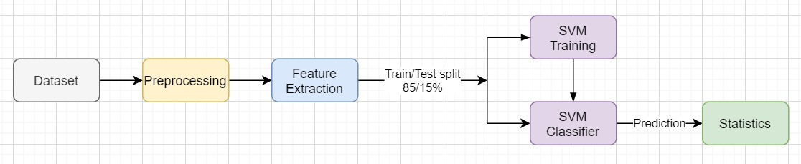
“Toy Problem”
Preprocessing:
“Cleaning” the texts
Tokenizing
Ignoring punctuation
Features:
Histogram of most frequent words
Histogram of least frequent words
Average word length
Number of words

Slide 14
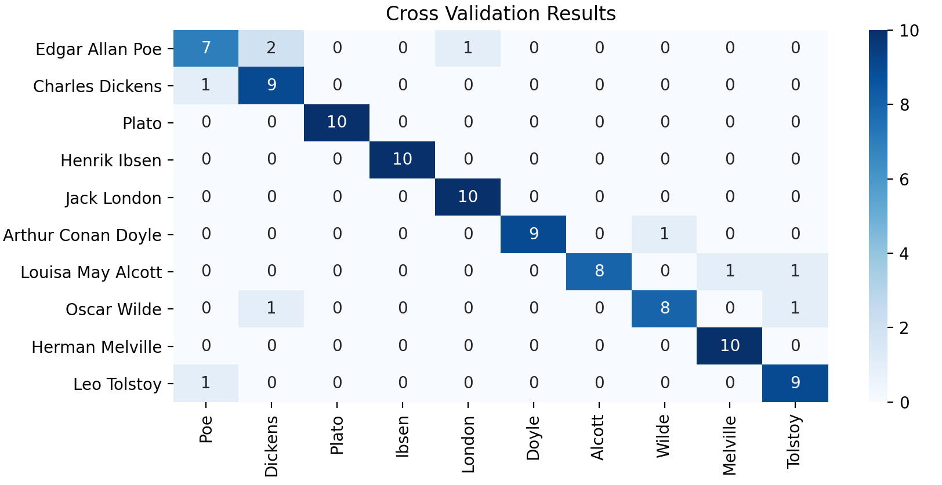
“Toy Problem” – Results
Mean Accuracy: 90%

Slide 15
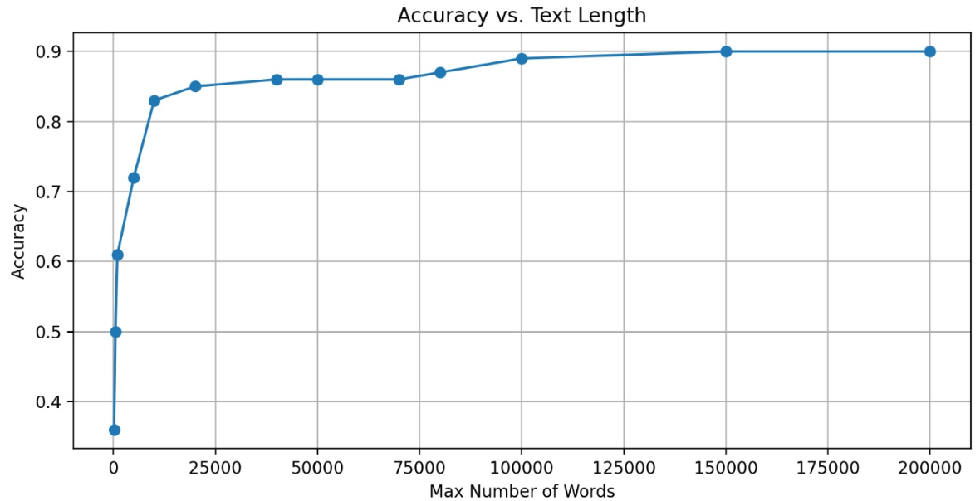
Text Length-Accuracy Ratio
Important test for understanding how to reach our goal.
Conclusion: the longer the text – the better accuracy.

Slide 16
The Main Project

Slide 17
Datasets – Challenging Characteristics
Academic papers:
Multiple authors.
Commonly appear in PDF format (inconvenient format).
Different text structures – hard for automation.
Difficulty to obtain papers of a specific person (for example: occasionally not free).

Slide 18
Datasets – Challenging Characteristics
Reviews:
Hard to find (especially labeled ones).
A possibility for number of reviews for the same paper (several versions).
Most of the review’s authors write only few reviews in total.
Occasionally very short texts without meaningful context.
Bias – mostly only reviews of accepted articles are available.

Slide 19
Datasets Structure
Train
Test
70 academic papers
7 authors
(10 each)
168 reviews
7 authors
(min. 8 each)
The reviews are from BMJ (British Medical Journal).
The papers are from various sources.
* Time-consuming manual work.

Slide 20
Evaluation Setups
We ran our model with the following data configurations:
Toy problem – for reference to a simple data configuration.
100 texts, 10 authors.
Train and test on academic papers.
70 texts, 7 authors.
Train and test on reviews.
168 texts, 7 authors,
Train on academic papers and test on reviews – for completeness of tests.
train set: 70 texts, test set: 168 texts.
Each configuration contributed to the project progress and conclusions.

Slide 21
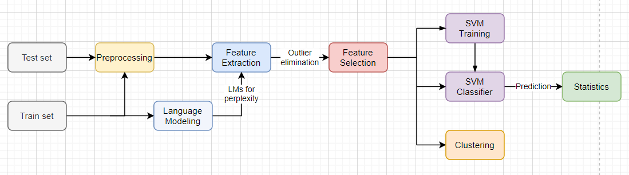
Block Diagram

Slide 22
Preprocessing
Tokenizing.
Ignoring stop words.
Lemmatization.
Replacing numbers and unordinary signs with ‘<UNK>’.
Dividing to train set and test set.

Slide 23
Feature Extraction
A key step of every ML project.
Analyzing the raw data for extraction of high-quality features with high correlation with classes.
The research of getting the suitable features - huge part of the project that was being performed during the entire project.

Slide 24
Features – n-grams
Dividing the text to tokens of n words.
Each group of words is being referred as a single token.
Method that helps to understand connections between words.
Example:
The | Little | Boy
Little | Boy | Went
Boy | Went | To
Went | To | School
The little boy went to school.
n = 3

Slide 25
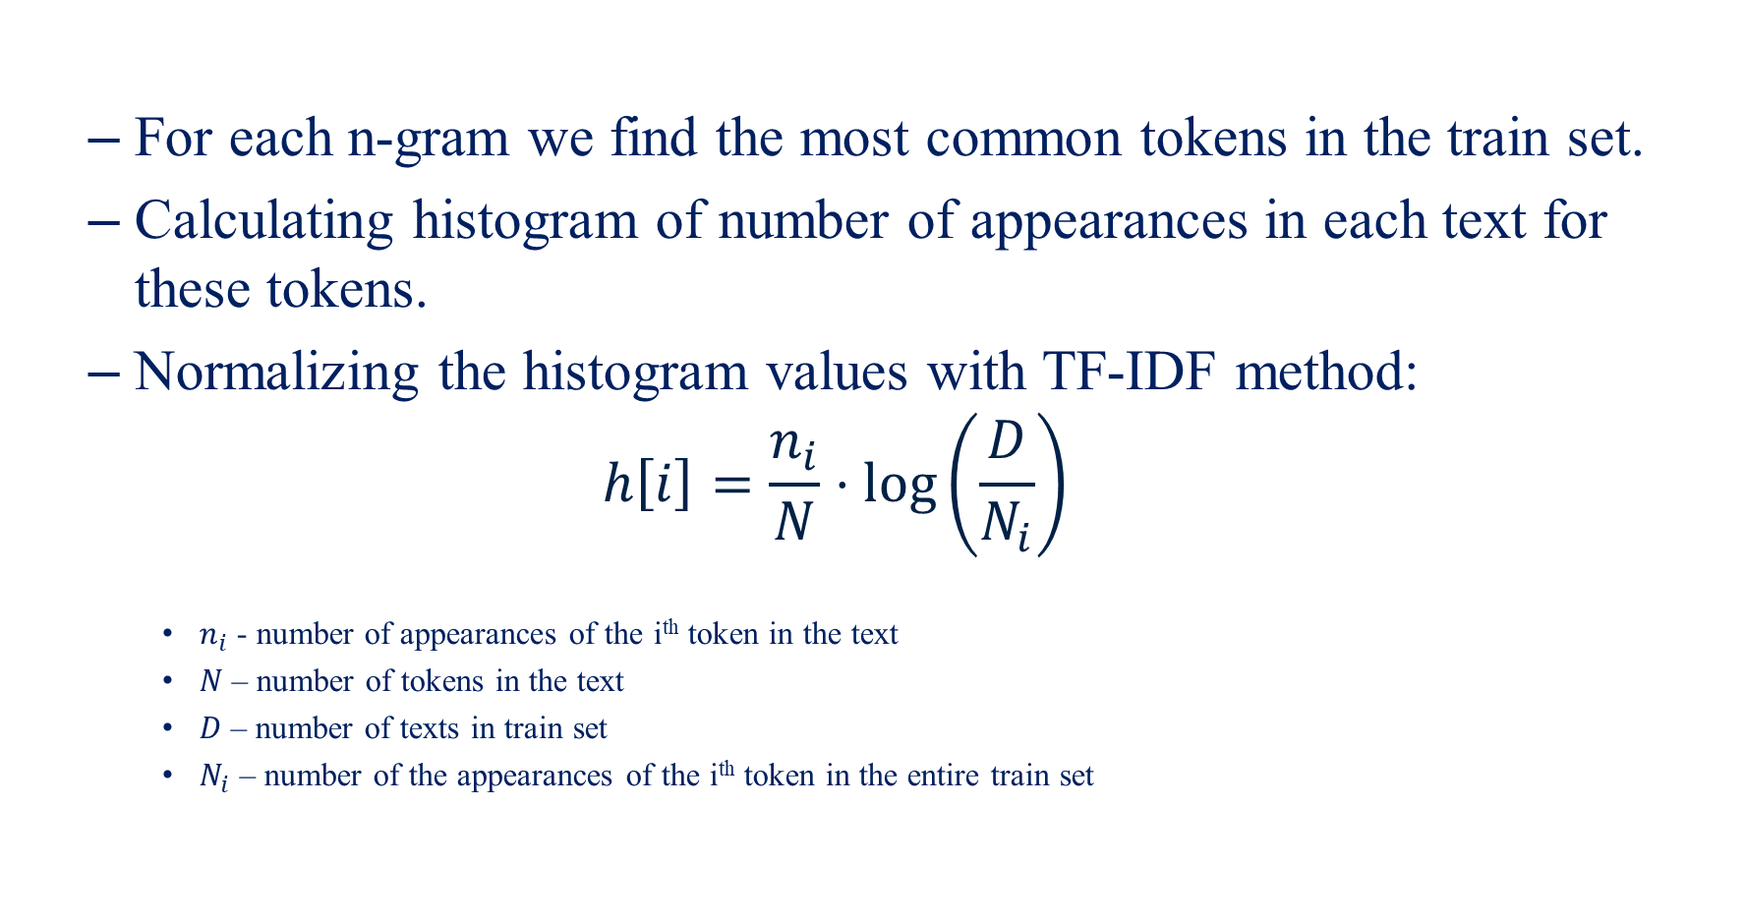
Features – n-grams
For each n-gram we find the most common tokens in the train set.
Calculating histogram of number of appearances in each text for these tokens.
Normalizing the histogram values with TF-IDF method:
$$h\left[i\right]=\frac{n_{i}}{N}⋅\log\left(\frac{D}{N_{i}}\right)$$
$n_{i}$ - number of appearances of the i^{th} token in the text
$N$ – number of tokens in the text
$D$ – number of texts in train set
$N_{i}$ – number of the appearances of the i^{th} token in the entire train set

Slide 26
Features – n-grams
TF-IDF is a research-proven method.
Its strength relies on the fact that we don’t want to over-weight words that have many appearances in a language (such as “the”).
In our project: 1-gram, 2-gram, 3-gram, 4-gram and 5-gram.
Each of the above has a different hyperparameter value of the number of tokens we take for the histogram.

Slide 27
Features
Additional features:
Average word length.
Number of words.
Average number of words in a sentence.
Histogram of the following punctuation signs: , : -

Slide 28
Features – Language Models
Perplexity
vector
LM1
Train Data
NN model
LM7
Test Data
Build a language model for each author using neural network.
Calculates the probability for the next word.
The input is a token stream and the output is a vector of probabilities of each token to come next.
We used LSTM (Long Short Term Memory).

Slide 29

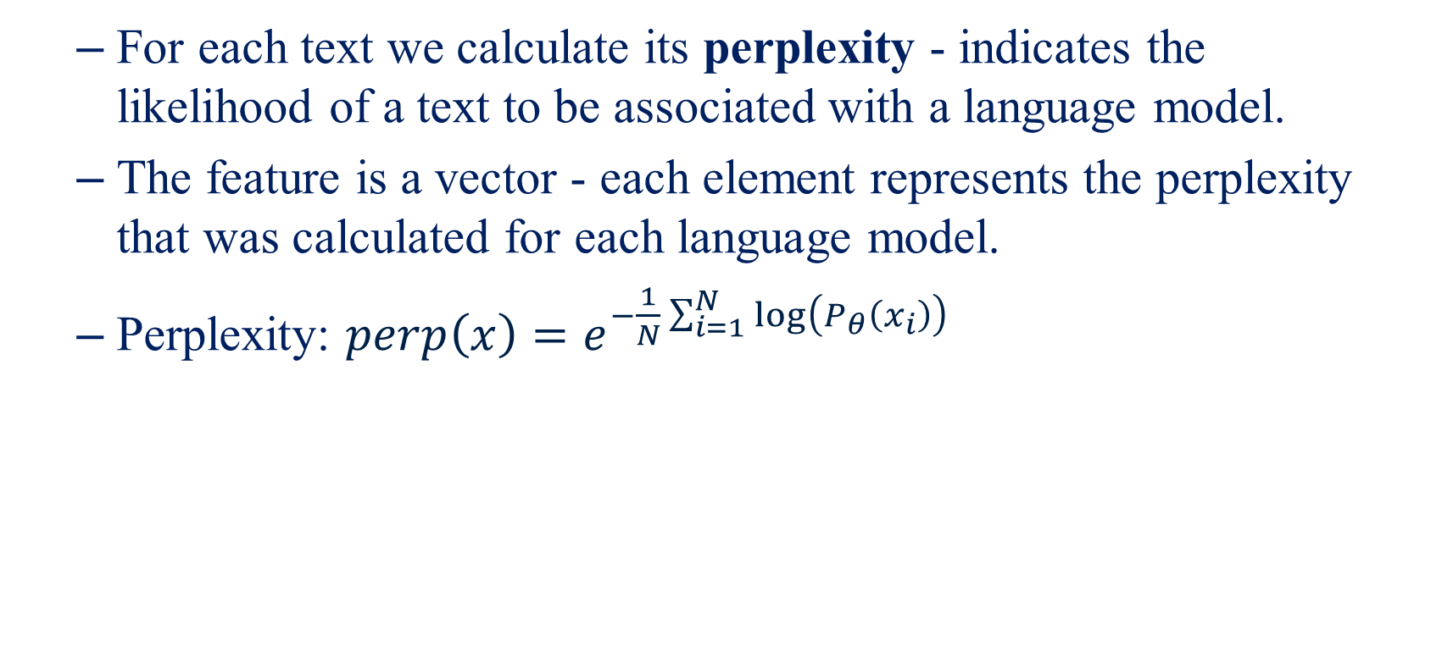
Features – Language Models
For each text we calculate its perplexity - indicates the likelihood of a text to be associated with a language model.
The feature is a vector - each element represents the perplexity that was calculated for each language model.
Perplexity: $perp\left(x\right)=e^{−\frac{1}{N}\sum_{i=1}^{N}{\log\left(P_{θ}\left(x_{i}\right)\right)}}$
$x$ - text
$x_{i}$ – token in the text
$N$ – number of tokens in the text

Slide 30
Features – Language Models
Smaller perplexity = better fit.
Language model gives understanding of vocabulary, writing style and more – highly valuable feature.
We started with our own neural network model.
It wasn’t good enough.

Slide 31
Features – Language Models
Ultimately, we chose a well-known neural network for language modeling – Hugginfaces’ GPT2 (by OpenAI).
A pre-trained model, on which we perform fine-tuning on our texts.
Much better results.
Low perplexity on train set.
Generated high-quality texts.

Slide 32
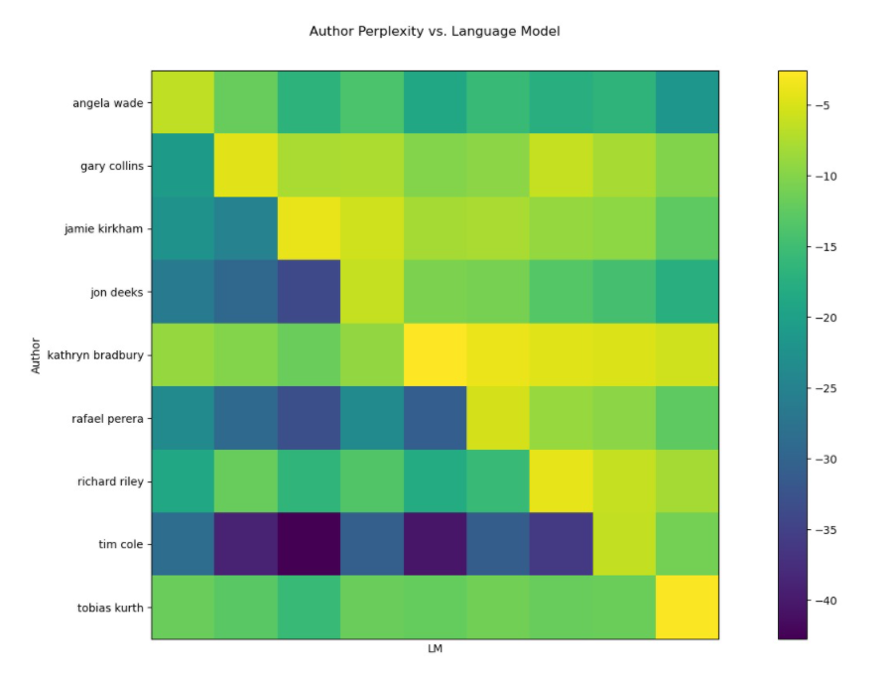
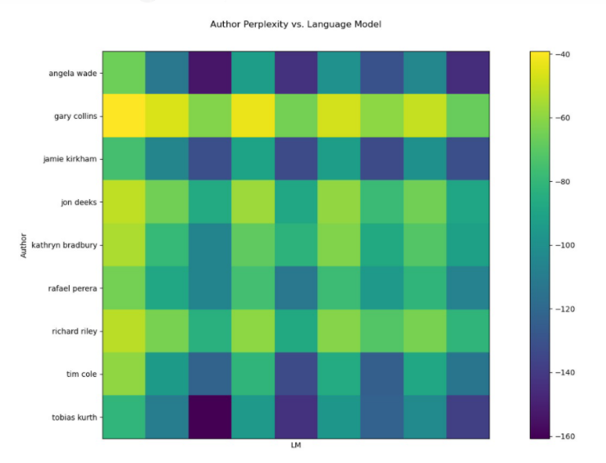
Features – Language Models
Minus perplexity confusion matrix:
Good results for articles-articles.
Worrying results for articles-reviews.
Articles - Articles
Articles - Reviews

Slide 33
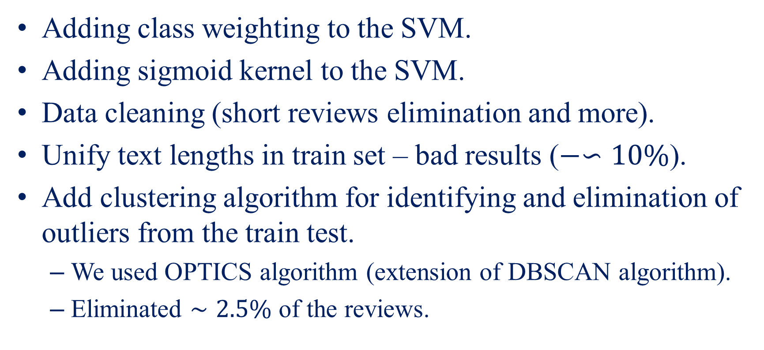
Additional Actions
Adding class weighting to the SVM.
Adding sigmoid kernel to the SVM.
Data cleaning (short reviews elimination and more).
Unify text lengths in train set – bad results ($−∽10\%$).
Add clustering algorithm for identifying and elimination of outliers from the train test.
We used OPTICS algorithm (extension of DBSCAN algorithm).
Eliminated $∼2.5\%$ of the reviews.

Slide 34
Additional Actions
Comparison between two perplexity feature methods –
Entire perplexity vector.
Argmin over the perplexity vector.
The first method was chosen as a result of various reasons:
Loss of information.
Irrelevance of absolute number to actual label.

Slide 35
Clustering
Why clustering?
Finding outliers in the datasets.
Samples visualization.
Examine whether the features result in clusters that resemble the true labels.
Learning the feature space.

Slide 36
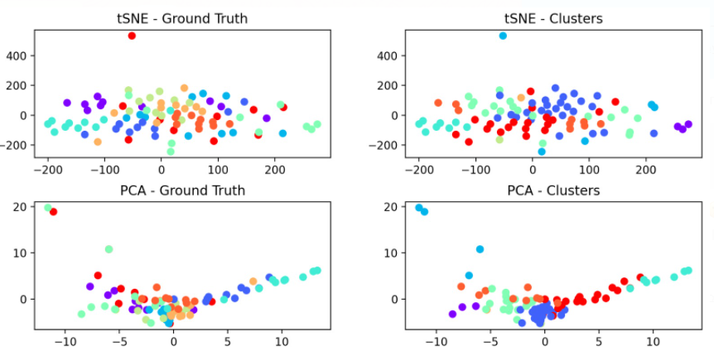
Clustering
Clustering using only the n-grams features:
* The colors on the right graphs are labels determined by k-means algorithm that was run on the original features space.

Slide 37
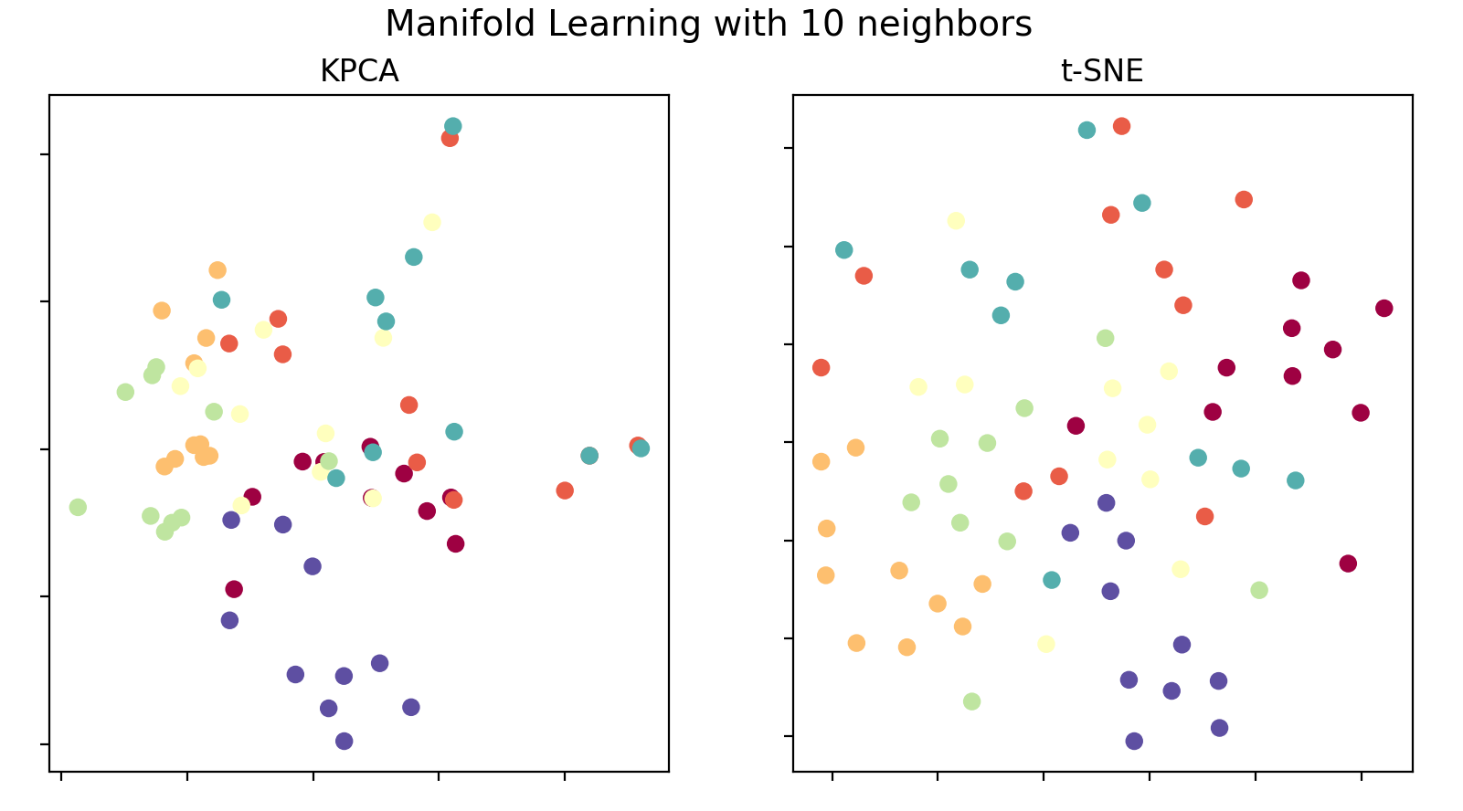
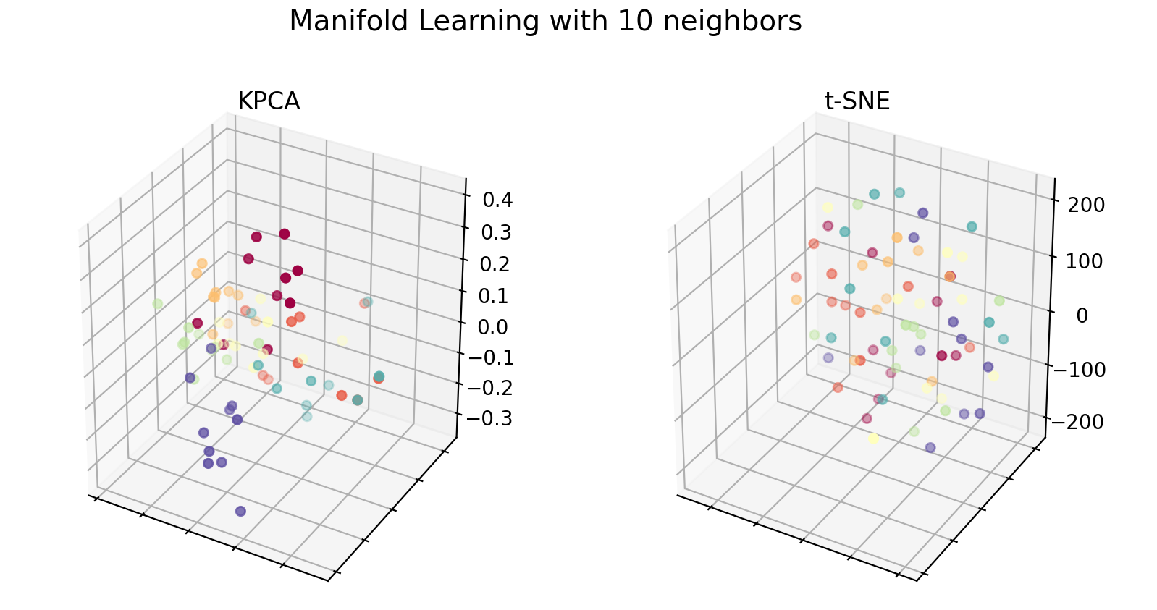
Clustering
During the project we examined different methods of non-linear dimensionality reduction methods (MDS, LLE and more).
We decided to show only KPCA (with sigmoid kernel) and tSNE (supervised for both).
Articles:

Slide 38
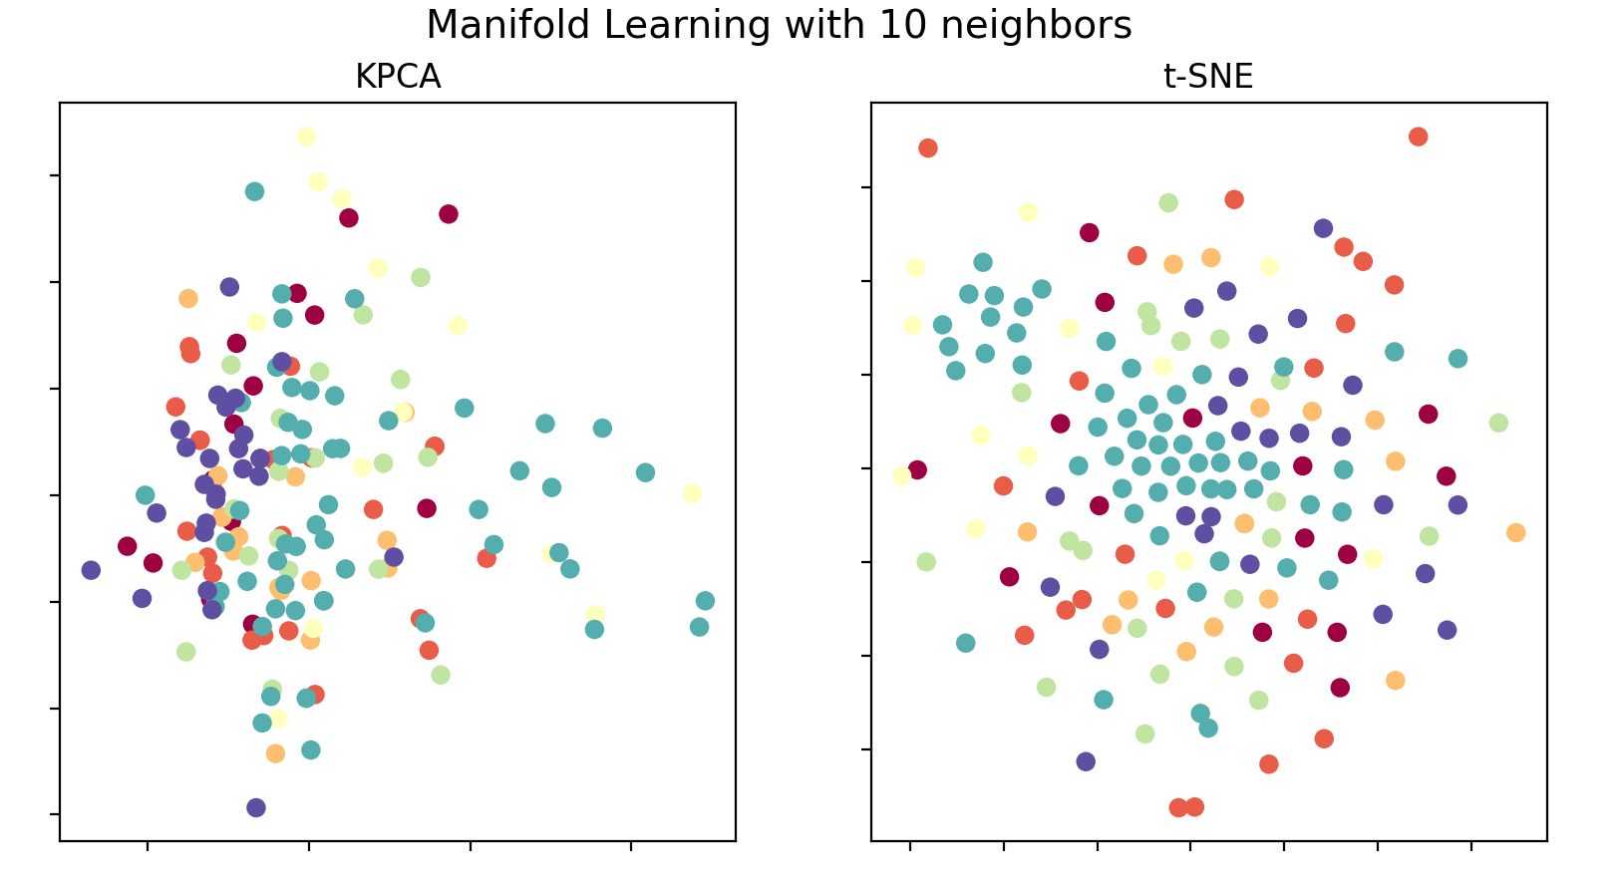
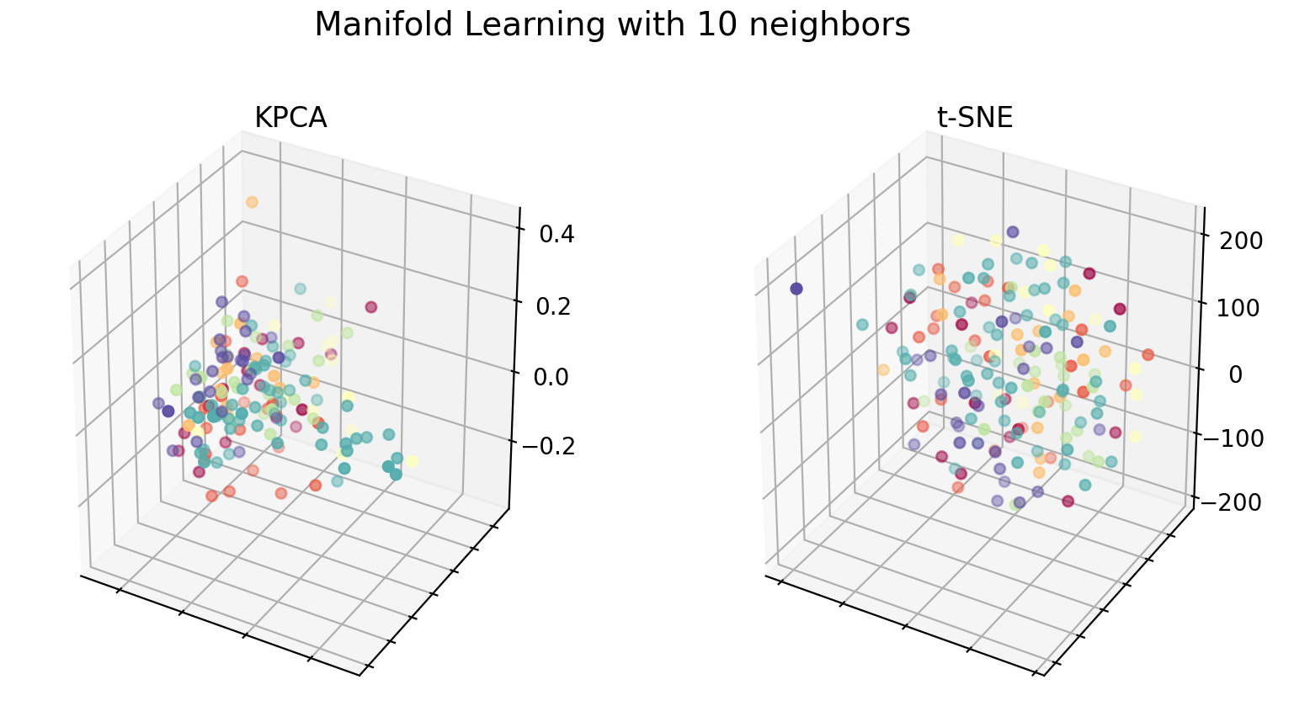
Clustering
Reviews:
Several texts from the same class cluster together, but not all.
Articles cluster better than reviews.

Slide 39
Feature Selection
Important part of the project.
Helps to eliminate features that don’t contribute to the classification task.
Or even have a negative contribution.
We chose to work with reliefF algorithm for feature selection.
Examined each domain separately to receive more domain-specific results.

Slide 40
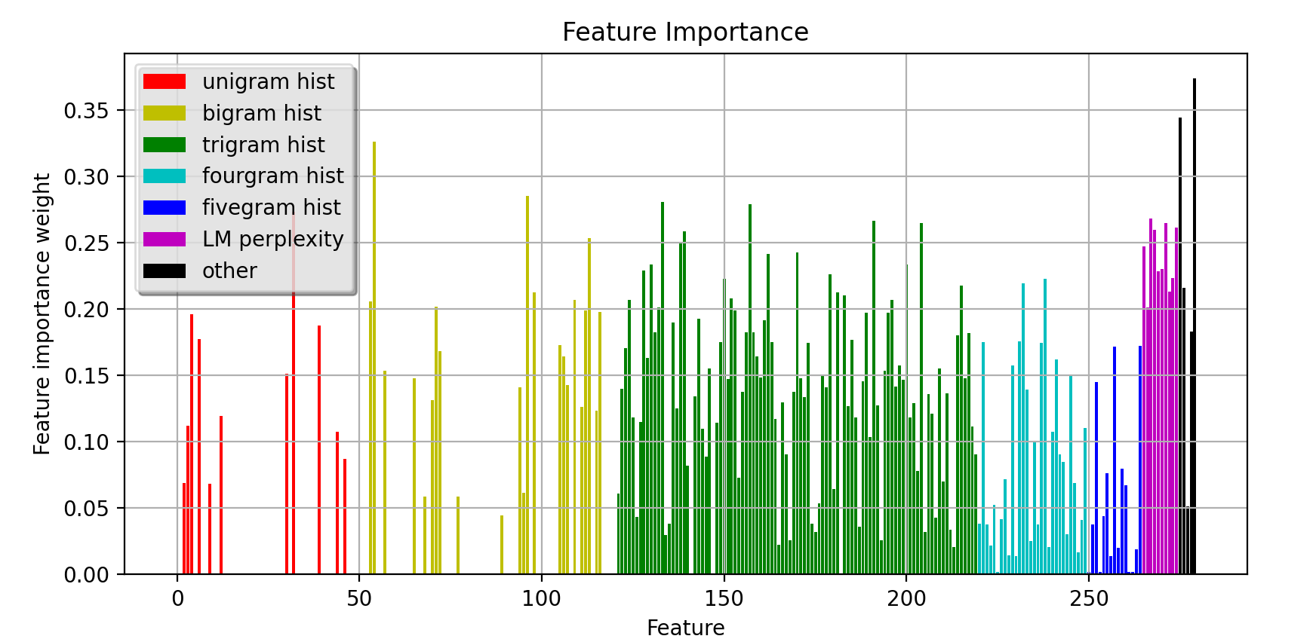
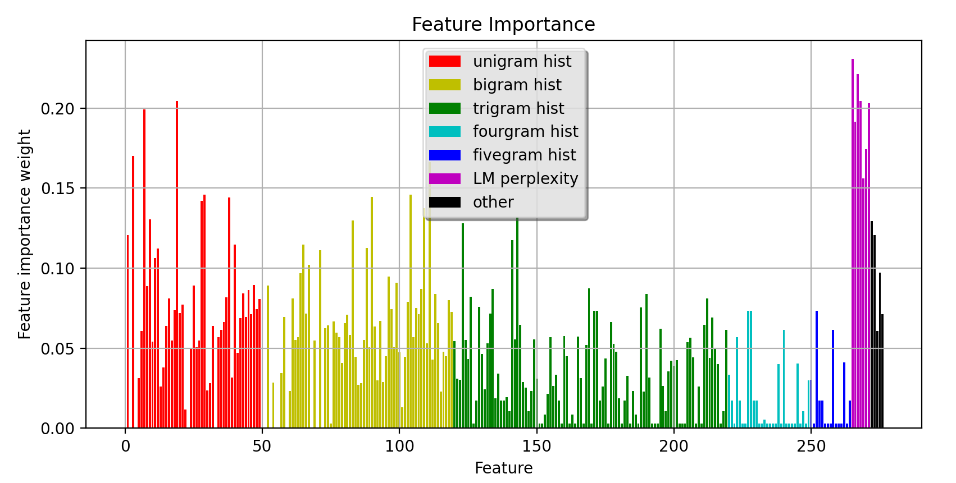
Toy problem:
Academic papers:

Slide 41
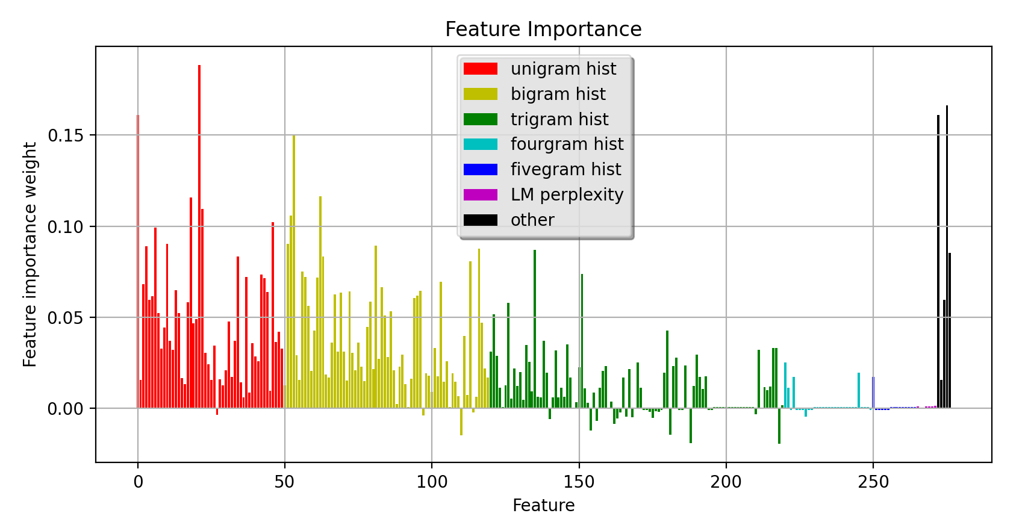
Reviews:
Shows the importance of using a good feature selection algorithm.

Slide 42
Results
The results will be shown as accuracy percentages on the test set using 10-fold cross-validation method.
Confusion matrix will be shown as well.

Slide 43
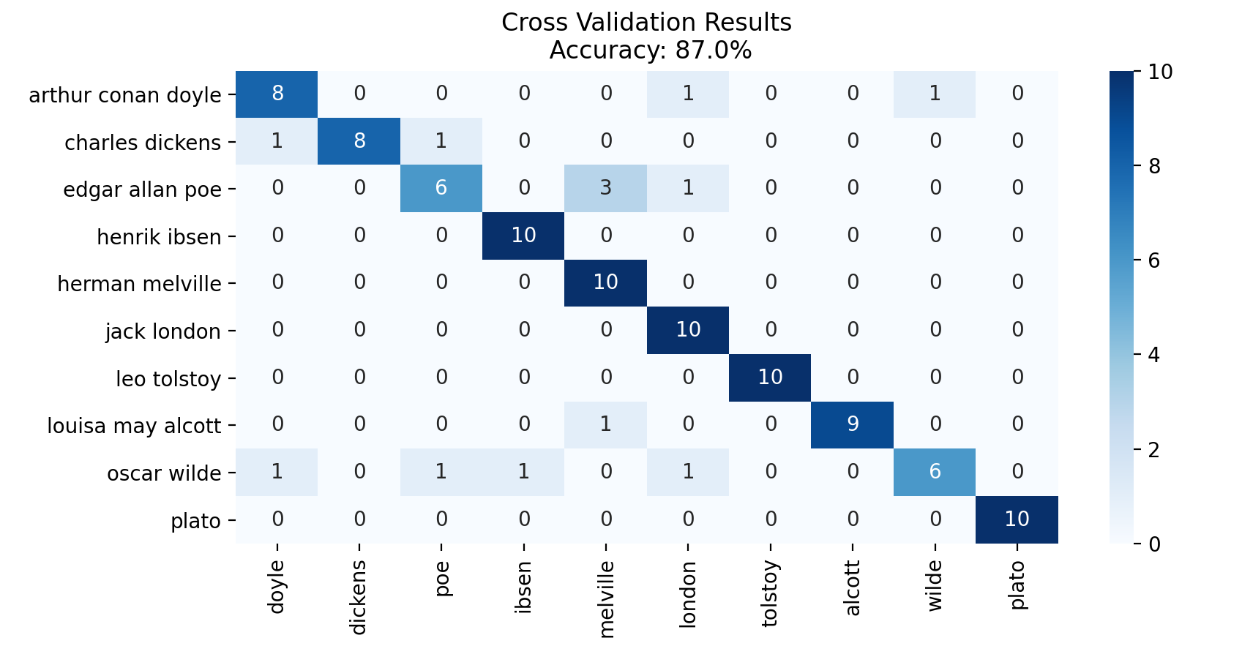
Results
Toy problem:

Slide 44
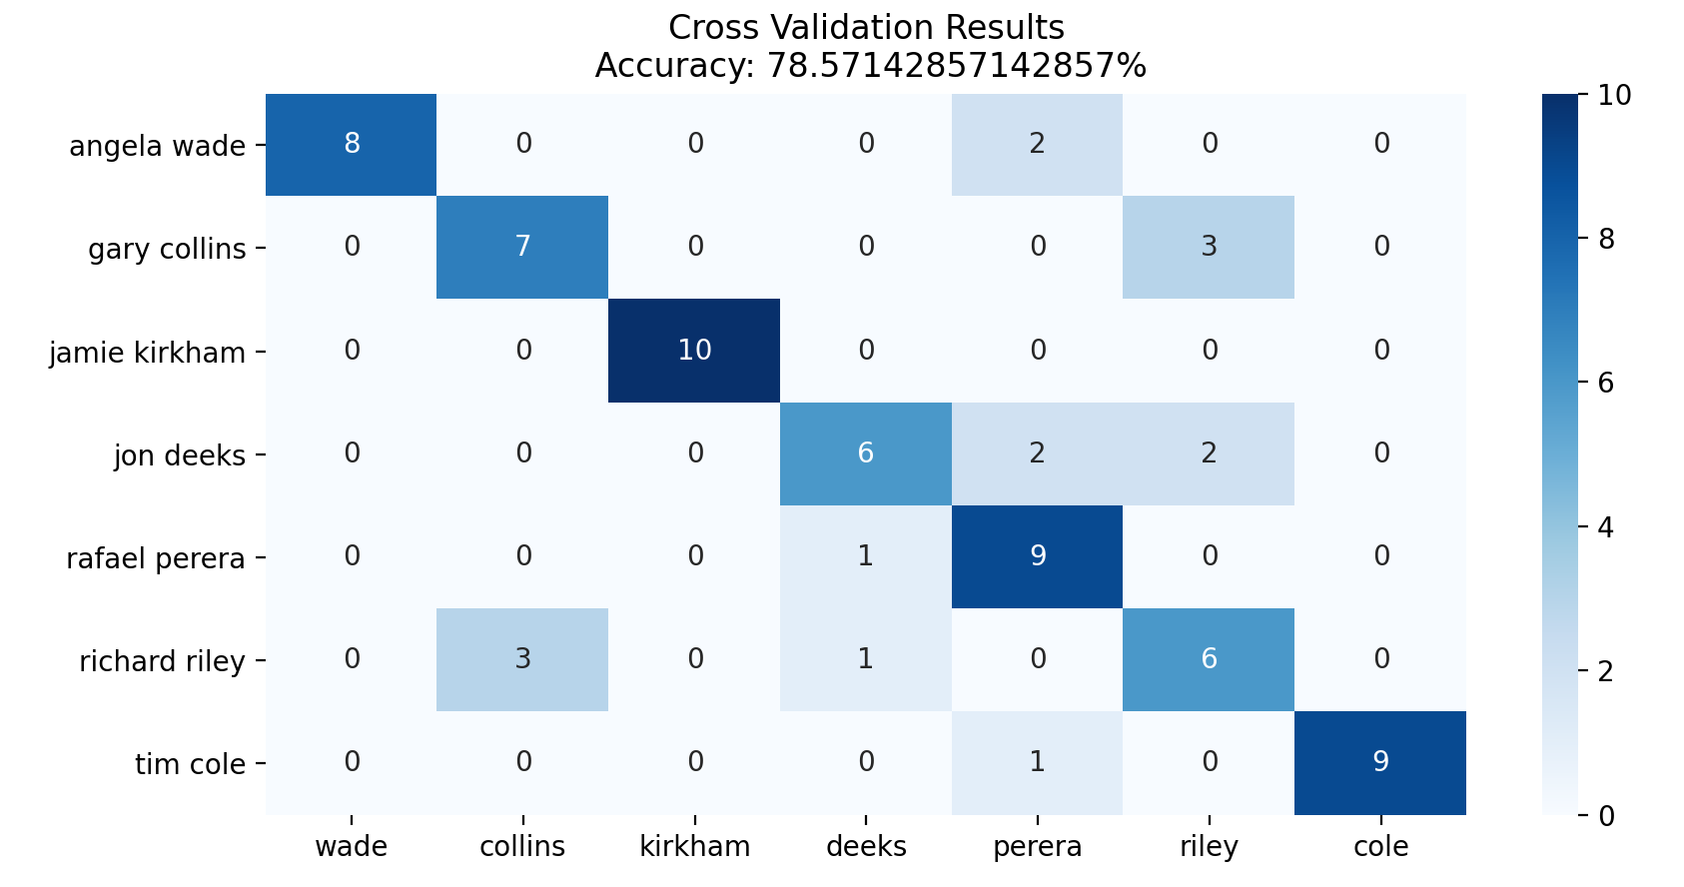
Results
Academic papers - academic papers:

Slide 45
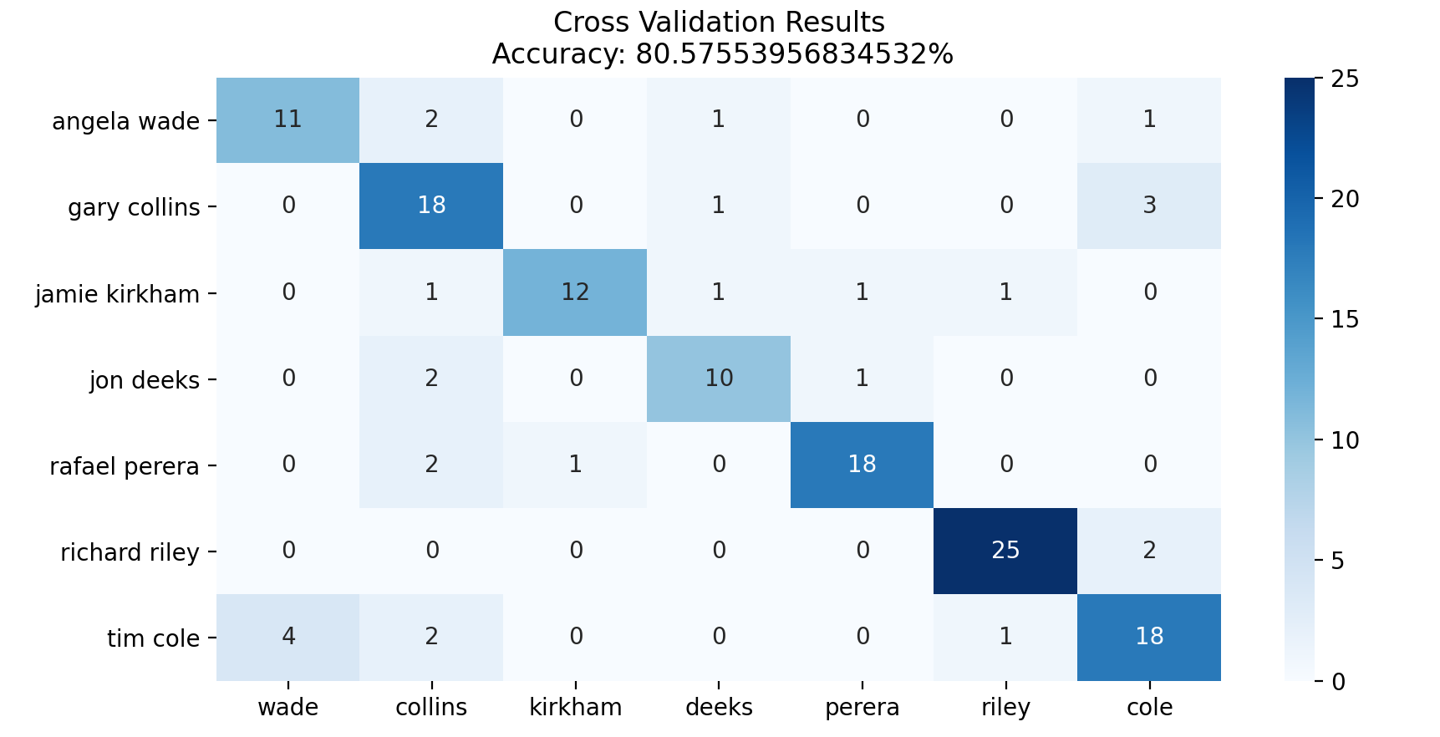
Results
Reviews - reviews:

Slide 46
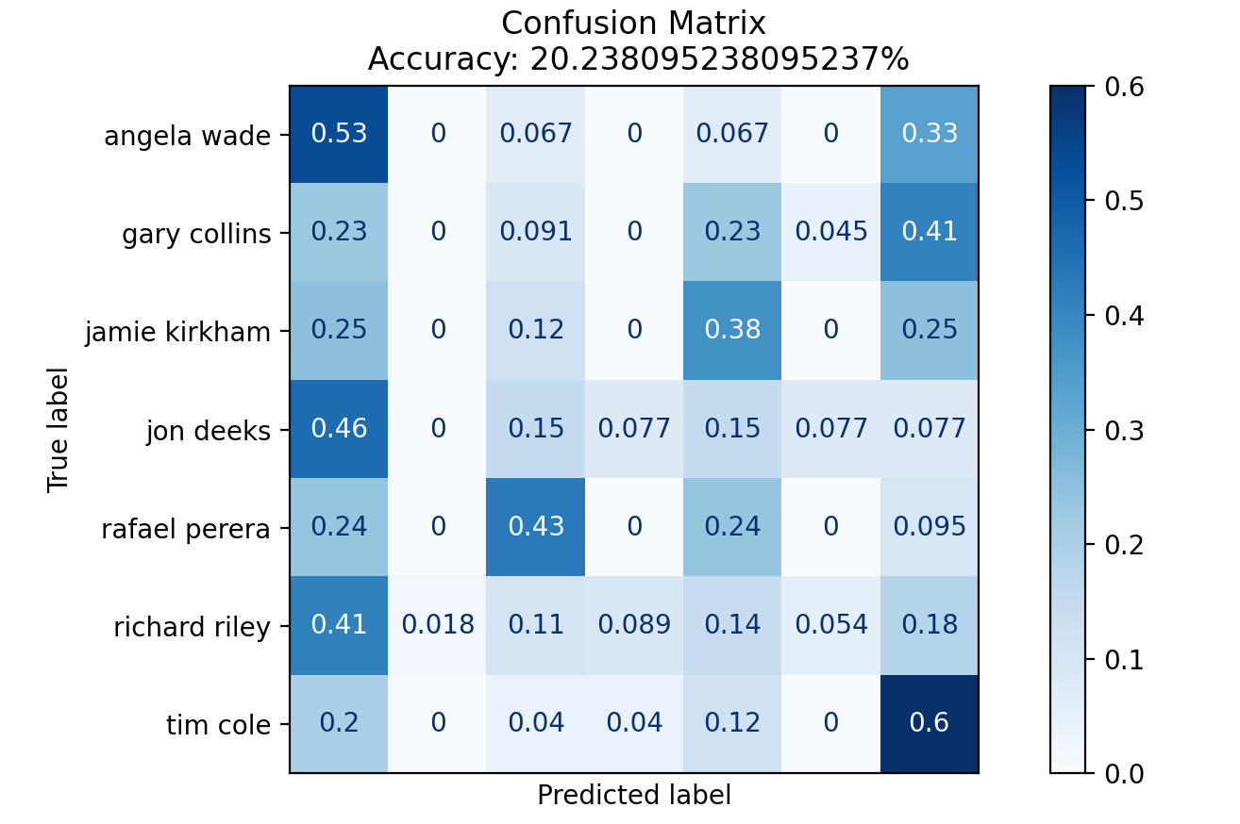
Results
Academic papers - reviews:

Slide 47
Results
84% on reviews configuration using a linear kernel.
30% on the cross-domain problem – but unbalanced predictions.
These results constitute the stepping-stone for possible future work.

Slide 48
Conclusions
The good results indicate on the stability of our model for various problems.
The quality and size of the dataset have impact on the results.
Text length may have a great impact on results.
Feature selection is important when dealing with high feature dimension.

Slide 49
Conclusions
Identification of best features for the task:
1-2-3-grams.
Various types of features (semantic, lexical, syntactic).
Perplexity of Language Models.
Dimensionality reduction and clustering – very useful in learning the dataset.

Slide 50
Future Work & Cross-Domain Problem
Improve and enlarge the datasets.
Use different scoring/success metrics and create a prediction ranking method.
Examine additional and existing features for cross-domain problem.
Domain adaptation for cross-domain problem.
Problem mitigation.

Slide 51
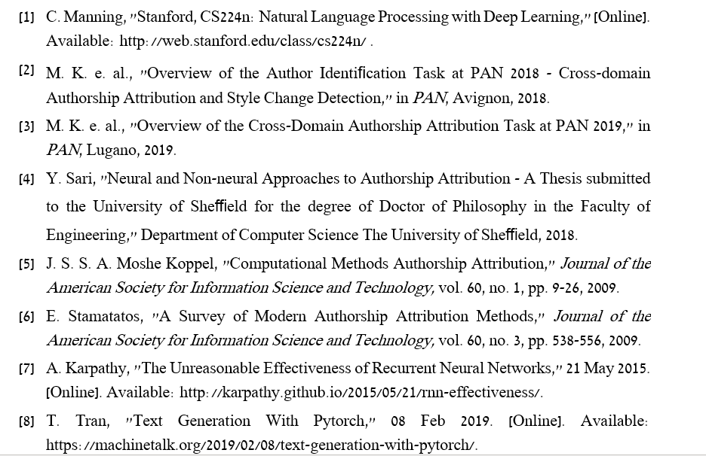
References

Slide 52
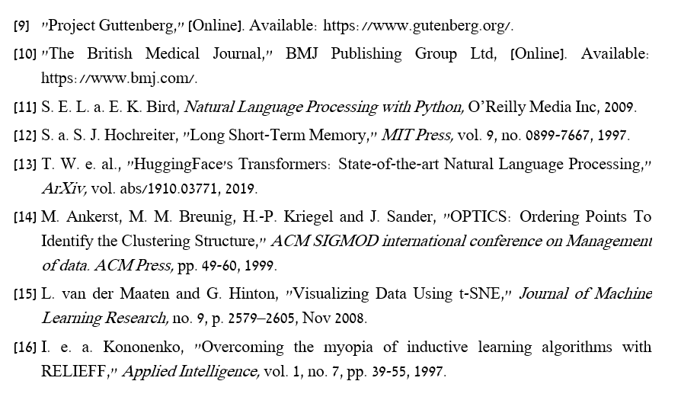
References

Slide 53
Thank you!

